Slide 1
CSS for Styling
By Jinzhu Gao

Slide 2
Web Page
A well-written web page:
HTML: the content of the document
Style Sheets (in CSS): the appearance of the document
Scripts (in languages such as JavaScript): the behavior of the document

Slide 3
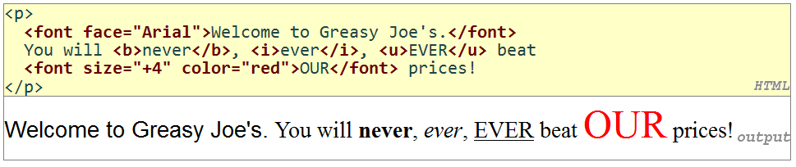
Old-school formatting (Bad!)
The elements such as b, i, u, and font are discouraged in strict HTML
Why?
Solution: use CSS
Notes:
Because they describe appearance and formatting rather than content

Slide 4
Cascading Style Sheets (CSS)
The core language for styling web pages
Properties of an element cascade together in this order:
browser's default styles
external style sheet files (in a <link> tag)
internal style sheets (in a <style> tag in the page header)
inline style (the style attribute of an HTML element)
Describes the way the contents (such as headings, paragraphs, images, lists) should look, such as colors, fonts, and alignment.
CSS Zen Garden

Slide 5
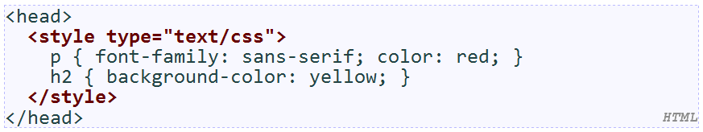
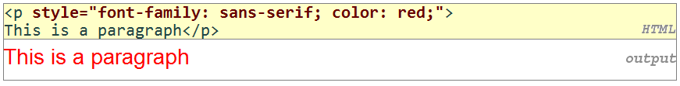
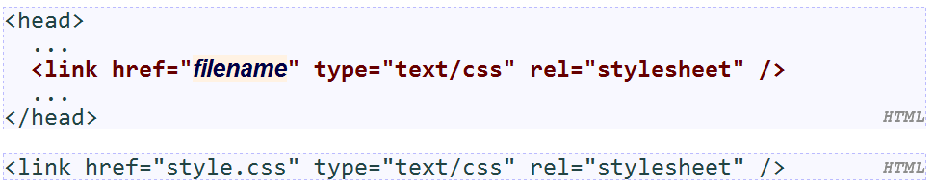
Cascading Style Sheets (CSS)
Three ways to add CSS info to a web page:
Inline with an individual HTML element with a style attribute
Embedded in the page’s head section as a style element
Placed into an external .css file and applied to the page using the link element
Which one to use? Why?
Notes:
Answer:
The CSS content is completely separated from the HTML, clean pages, easier to read and more conceptually pure
Can be used by many HTML documents

Slide 6
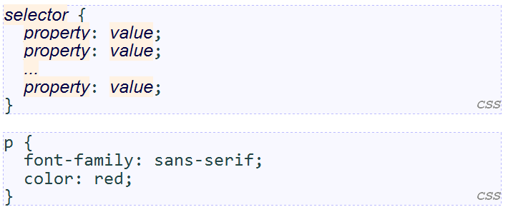
CSS Syntax
A CSS file contains one or more rules and each rule consists of one or more selectors
Rule: a CSS statement describing a set of page tags and a set of styles to apply to those tags.
Selector: describe which content the style applies to.
Property: a stylistic aspect that can be set in a CSS rule.

Slide 7
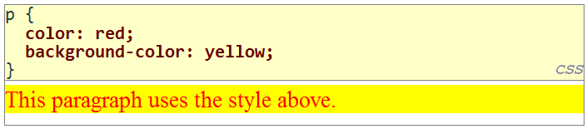
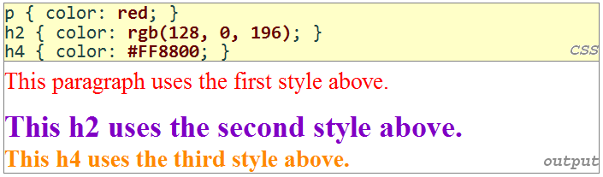
Color Properties
Property | color | background-color
Description | Element’s foreground(text) color | Element’s background color
Value | A color (specified as a name[aqua, black, blue, fuchsia, gray, green, lime, maroon, navy, olive, purple, red, silver, teal, white, yellow], RGB [red, green, and blue values from 0 (none) to 255 (full)], or hex [RGB values in base-16 from 00 (0, none) to FF (255, full)])

Slide 8
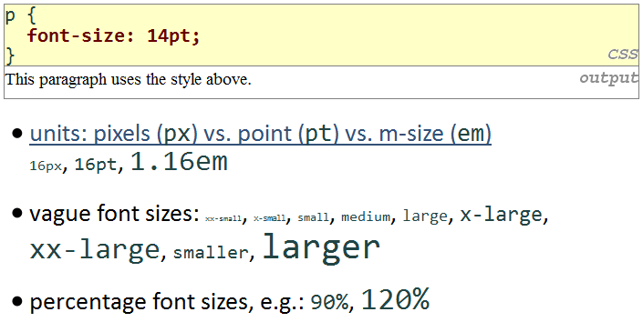
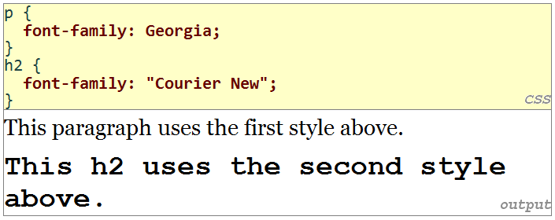
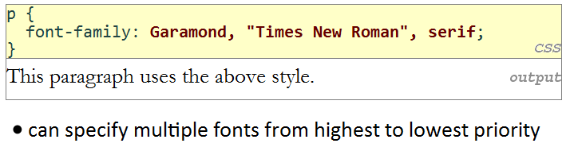
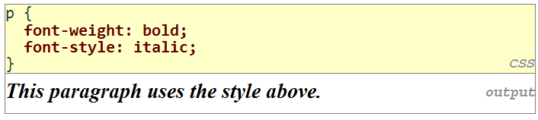
Font Properties
Property | Description | Value
font-family | Font name to use | A name such as serif, sans-serif, cursive, fantasy, monospace
font-size | Size of text to display | A unit value, percentage, or named value
font-style | Whether or not to italicize text | normal (default), italic
font-weight | Whether or not to bold text | normal (default), bold

Slide 9
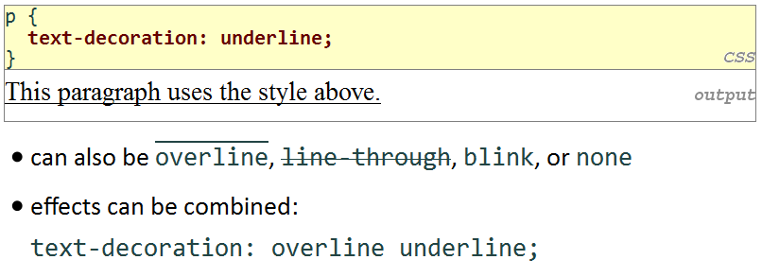
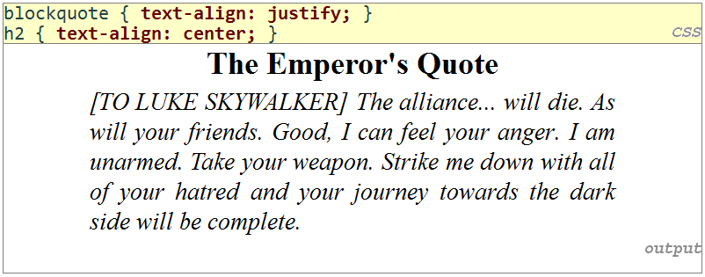
Text Properties
CSS Property | Description | Values
text-align | Alignment of inline content | left, center, right ,justify
text-indent | Indent first line | A size (px, pt, %, em)
text-decoration | Underline, etc. | underline, overline, line-through, blink, none
letter-spacing | Horizontal gap between letters | A size (px, pt, %, em)
line-height | Vertical size of each line | A size (px, pt, %, em)
word-spacing | Horizontal gap between words | A size (px, pt, %, em)

Slide 10
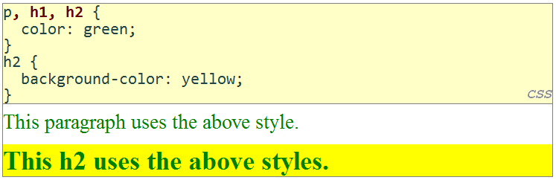
Grouping Styles

Slide 11
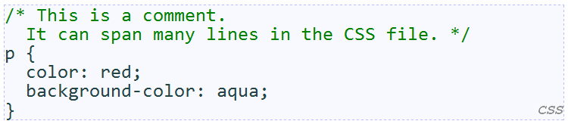
CSS comments

Slide 12
Self-Check
What’s wrong with the following CSS code? Identify at least four syntax errors or mistakes.
p {
background-color: red;
foreground color: yellow;
Font-Family: Times New Roman, serif;
}
h1, h2, h3, {
font-style: bold;
font-size: 24em;
}
Notes:
No “foreground color”, just “color”
Should use “Times New Roman”
h1, h2, h3 should not have same font style and font size
24em is way too big

Slide 13
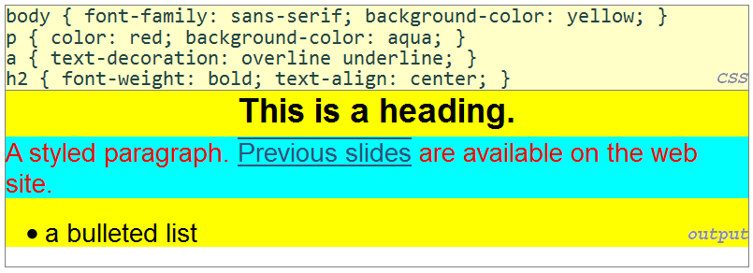
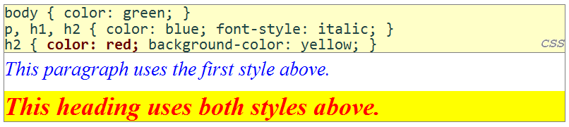
Style Inheritance and Conflicts
Inheritance: from the outer element to the inner one
CSS precedence:
The more specific or closely matching selector “wins”
When two styles set conflicting values for the same property, the latter style takes precedence

Slide 14
IDs and ID Selectors
ID:
An attribute uniquely identifying a HTML element
Begin with a letter followed by letters, digits, hyphens, underscores, colons and periods (no spaces)
Must be unique throughout the document
ID Selector
A CSS rule that applies only to a particular element on the page with a given ID.
Contains a hash sign (#) followed by the id
<h2 id=“europe”>Europe</h2>
#europe {
font-style: italic;
}

Slide 15
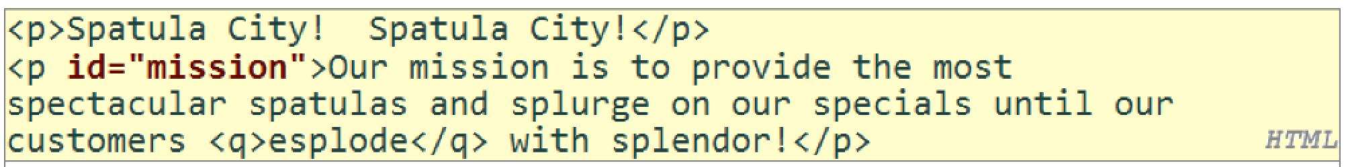
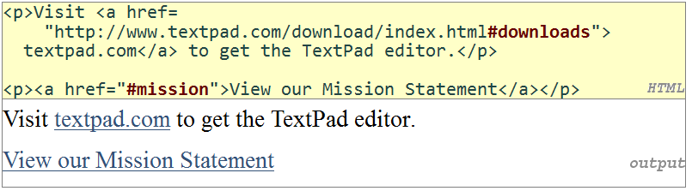
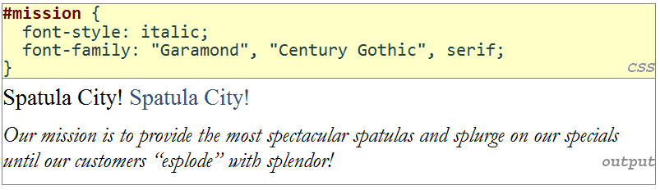
Links to Selections of a Page

Slide 16
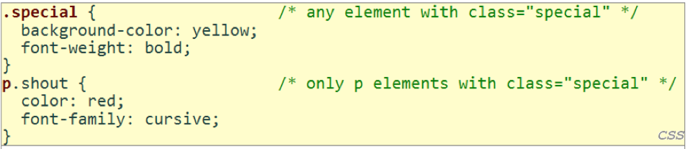
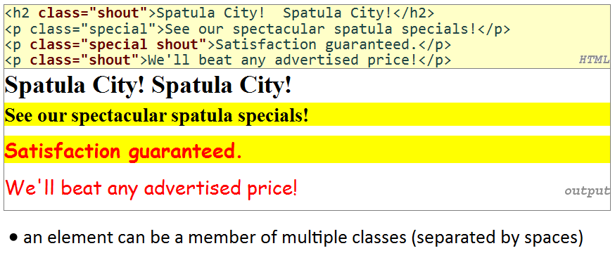
Classes and Class Selectors
Class attribute: an identifier that can be attached to any HTML element
Multiple elements can have the same class value
Class selector: a CSS rule that applies only to particular element(s) on the page that have a given class

Slide 17
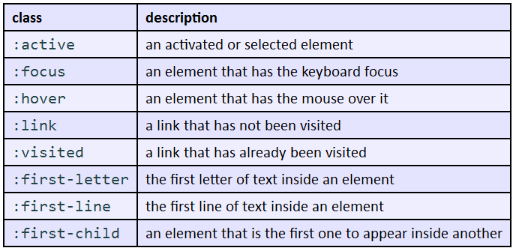
CSS pseudo-classes

Slide 18
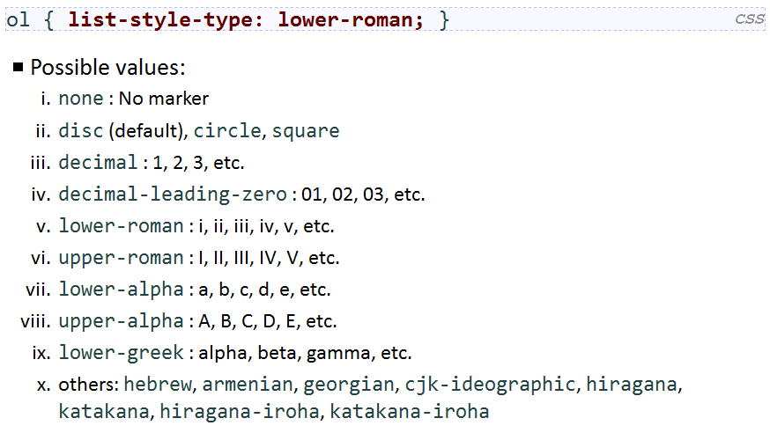
CSS for Lists

Slide 19
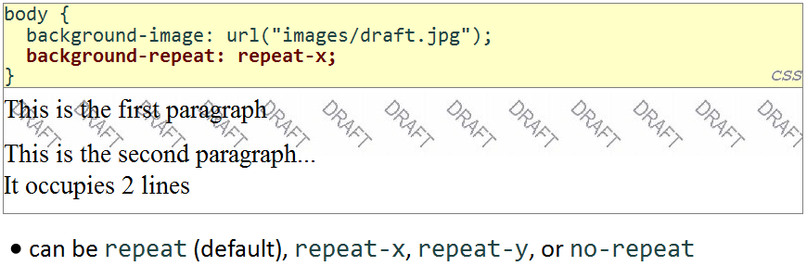
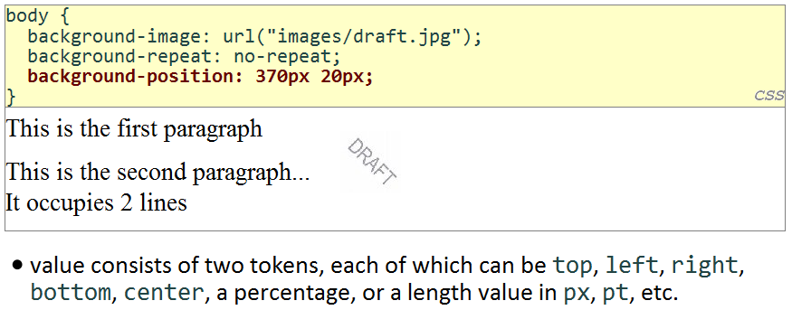
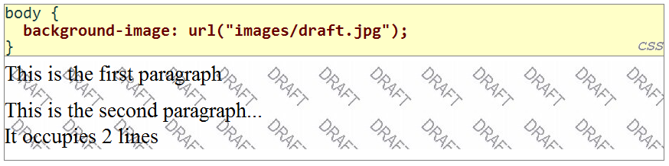
CSS properties for backgrounds
Property | Description
background-color | Color to fill background
background-image | Image to place in background
background-position | Placement of bg image within element
background-repeat | Whether/how bg image should be repeated
background-attachment | Whether bg image scrolls with page
background | Shorthand to set all background properties

Slide 20
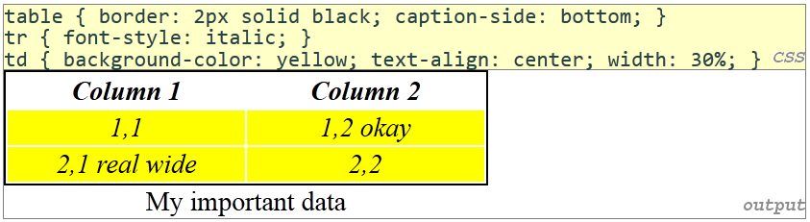
Styling Tables
All standard CSS styles can be applied to a table, row, or cell
Table specific CSS properties:
border-collapse, border-spacing, caption-side, empty-cells, table-layout

Slide 21
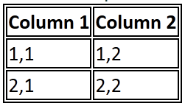
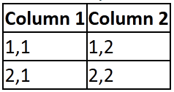
The border-collapse property
By default, the overall table has a separate border from each cell inside
The border-collapse property merges these borders into one
Without border-collapse
With border-collapse

Slide 22
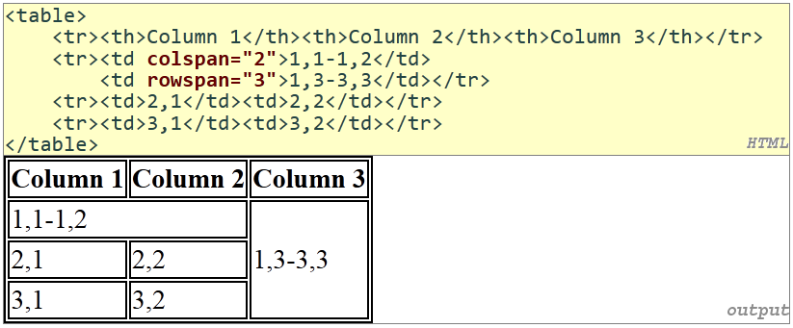
The rowspan and colspan attributes
colspan makes a cell occupy multiple columns
rowspan multiple rows
text-align and vertical-align control where the text appears within a cell

Slide 23
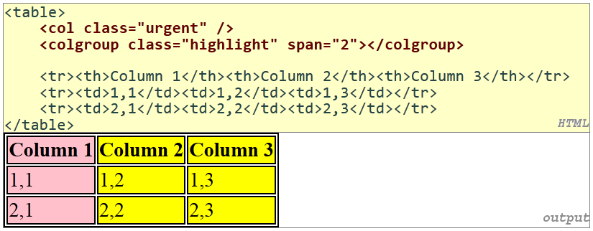
Column styles: <col>, <colgroup>
col tag can be used to define styles that apply to an entire column (self-closing)
colgroup tag applies a style to a group of columns (NOT self-closing)

Slide 24
Don’t use tables for layout!
(borderless) tables appear to be an easy way to achieve grid-like page layouts
many "newbie" web pages do this
but, a table has semantics; it should be used only to represent an actual table of data
instead of tables, use divs, widths/margins, floats, etc. to perform layout

Slide 25



CSS 3 New Feature
New selectors: nth-child, inline-block, :not, +
ability to embed fonts in a page (yay)
easy built-in support for multi-column layouts
transparency/opacity, color gradients, shadows
rounded corners/borders
animations and transitions (like Scriptaculous)
affine transformations (scaling, rotation, perspective)

Slide 26
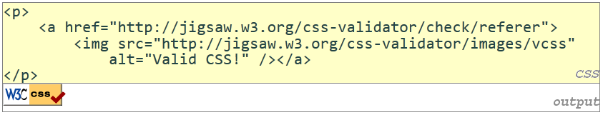
W3C CSS Validator
jigsaw.w3.org/css-validator/

Slide 27
Self-Check
Page 78-79
Reading assignment: Section 3.4 Case Study: Traveler Times

Slide 28
Summary
CSS properties for colors, fonts and other text properties
Style inheritance and confliction
HTML id attribute and class attribute

